Slide 1
DIDACTIC CASE TO LEARN OCULAR PATHOLOGY
Abelardo A. Rodríguez-Reyes, M.D.
Asociación para Evitar la Ceguera en México, I.A.P.

Slide 2
Disclosure of Relevant Financial Relationships
Dr. Abelardo A. Rodríguez-Reyes declares he has no conflict(s) of interest to disclose

Slide 3

Clinical Summary
A 22-year-old man
History of Herpes Zoster on the back for the previous 10 Years
Decreased vision in the right eye (OD) for 1 day
Ophthalmological examination OD: Hyperemic conjunctiva, ciliary injection, corneal leukoma, immunological ring and stromal edema

Slide 4
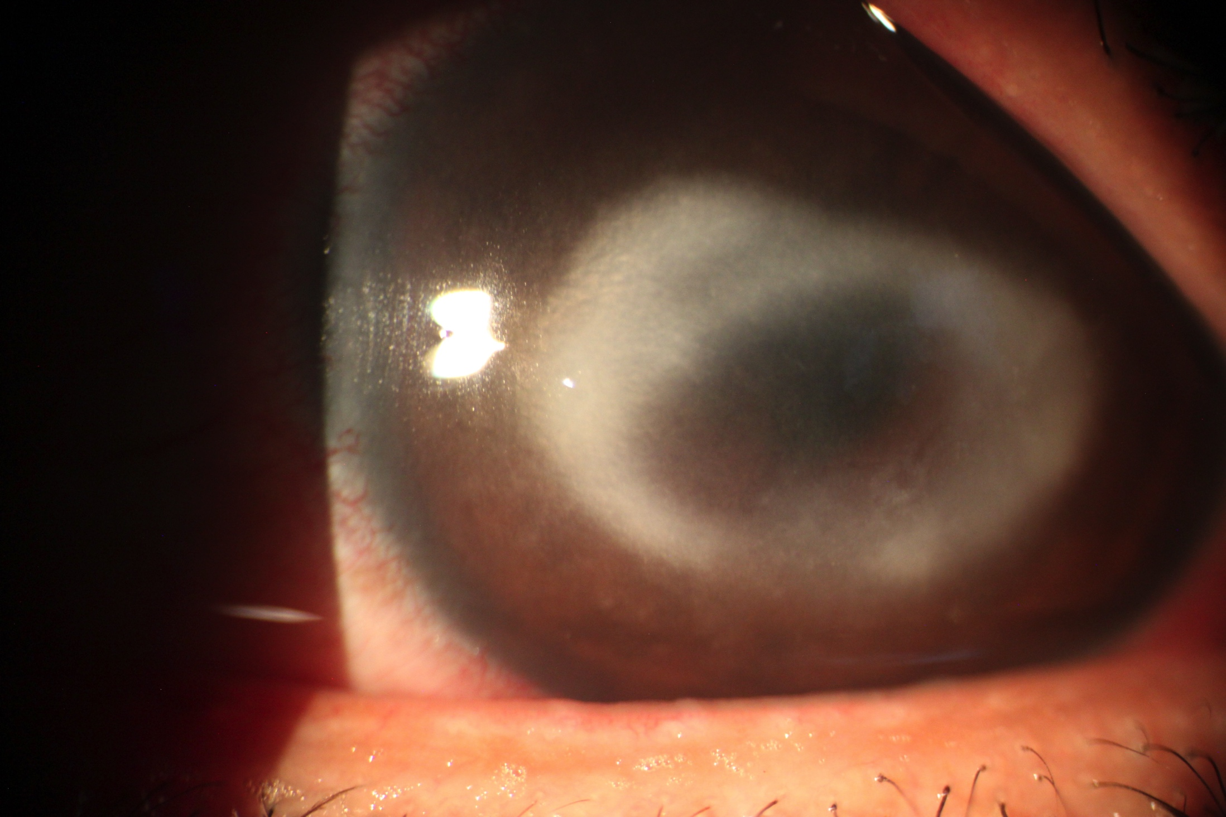
Clinical Appearance

Slide 5
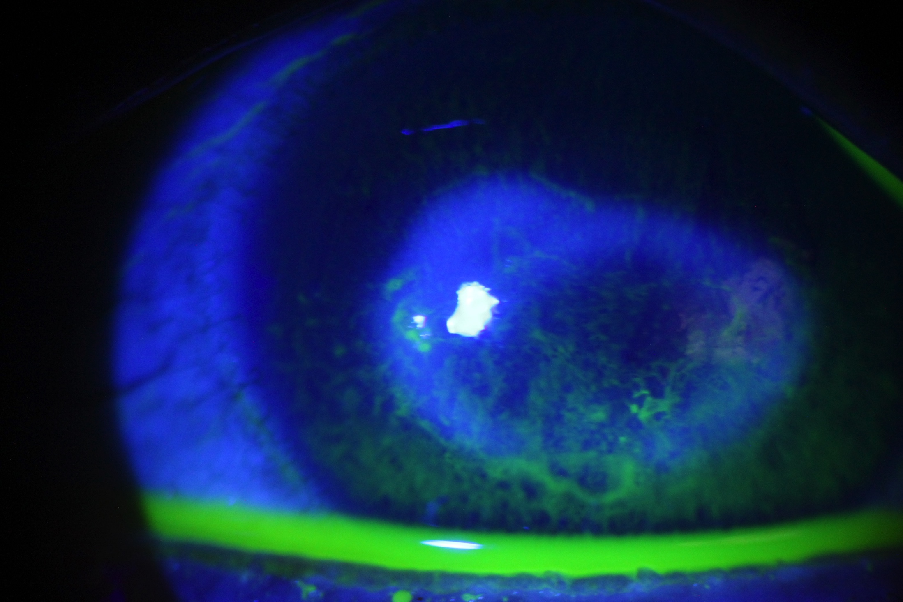
Clinical Appearance

Slide 6
Treatment
Penetrating Keratoplasty

Slide 7
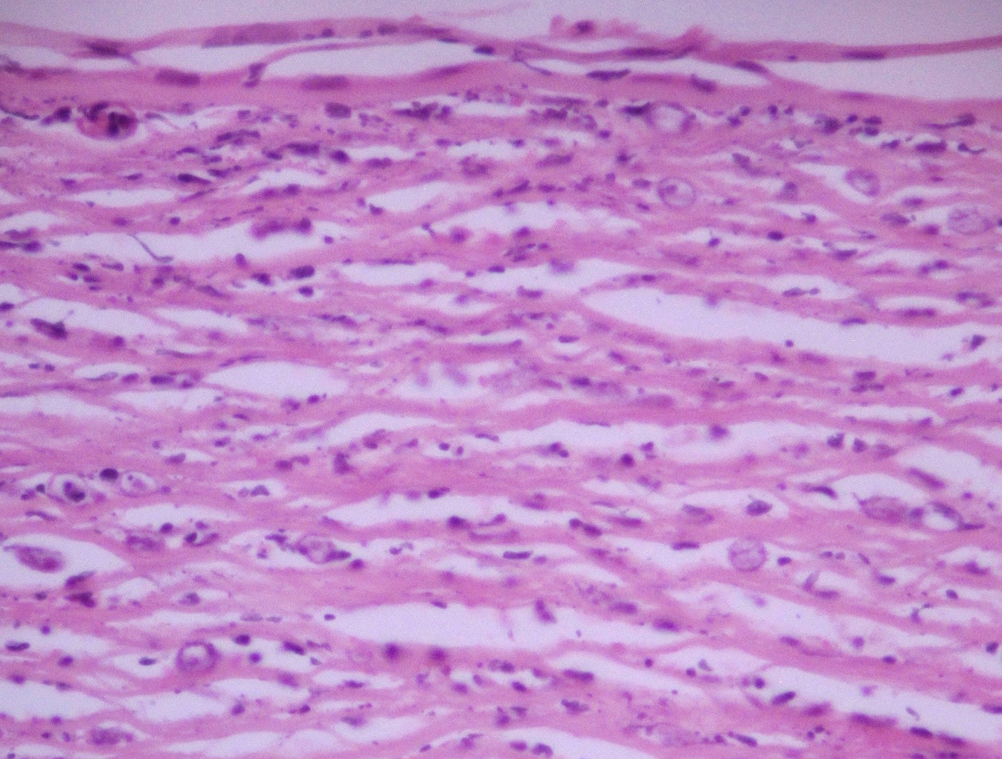
H&E

Slide 8
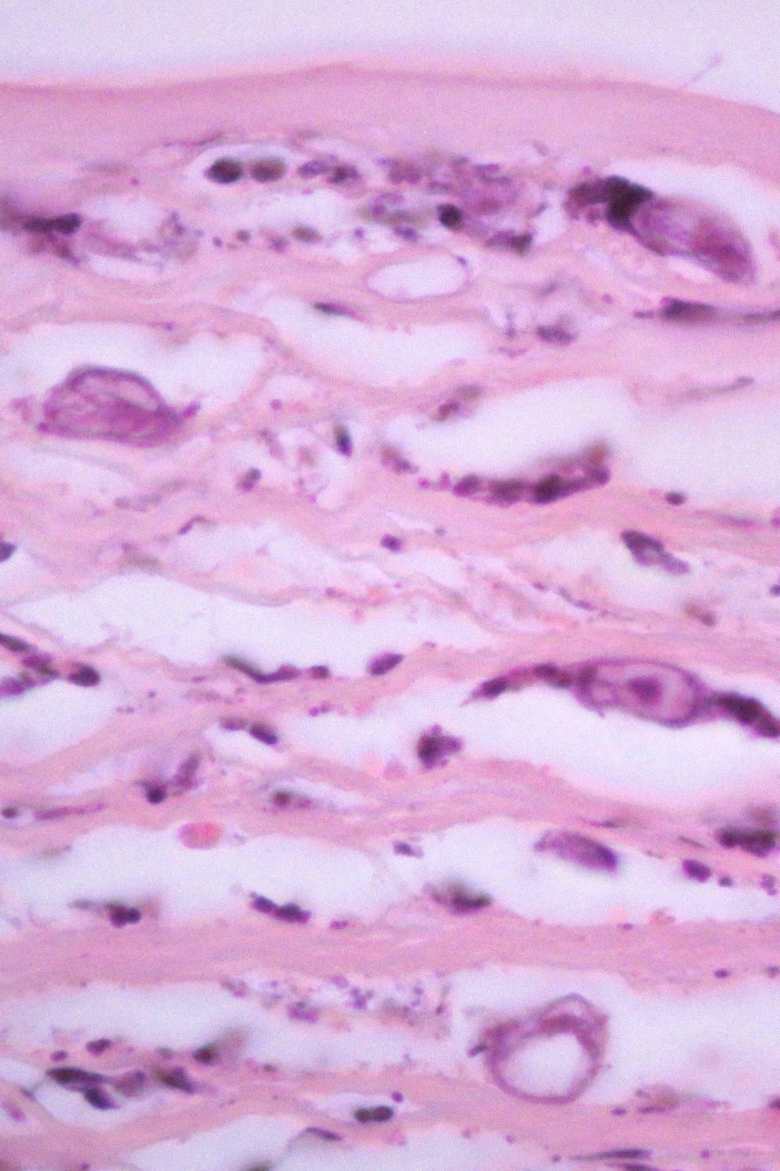
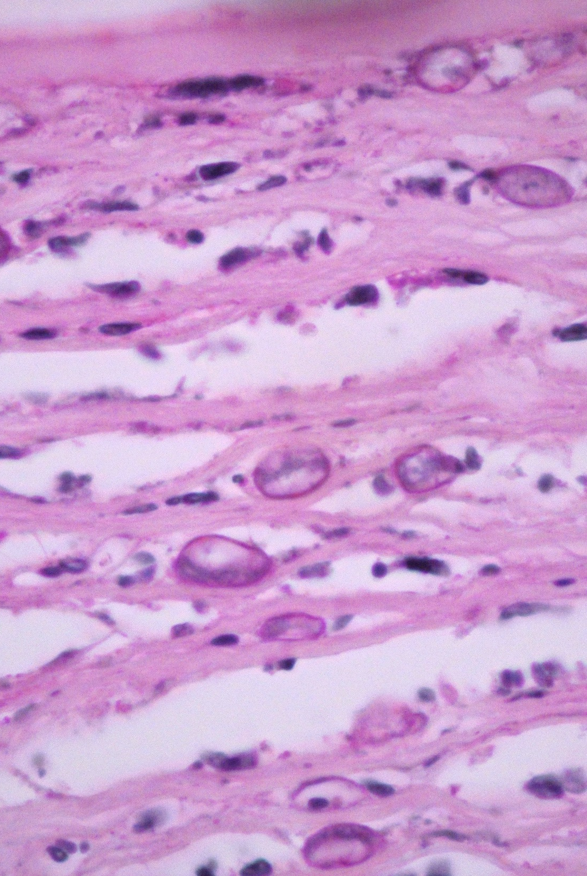
H&E
PAS

Slide 9
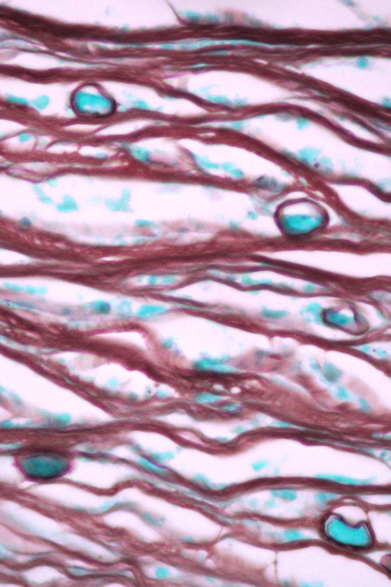
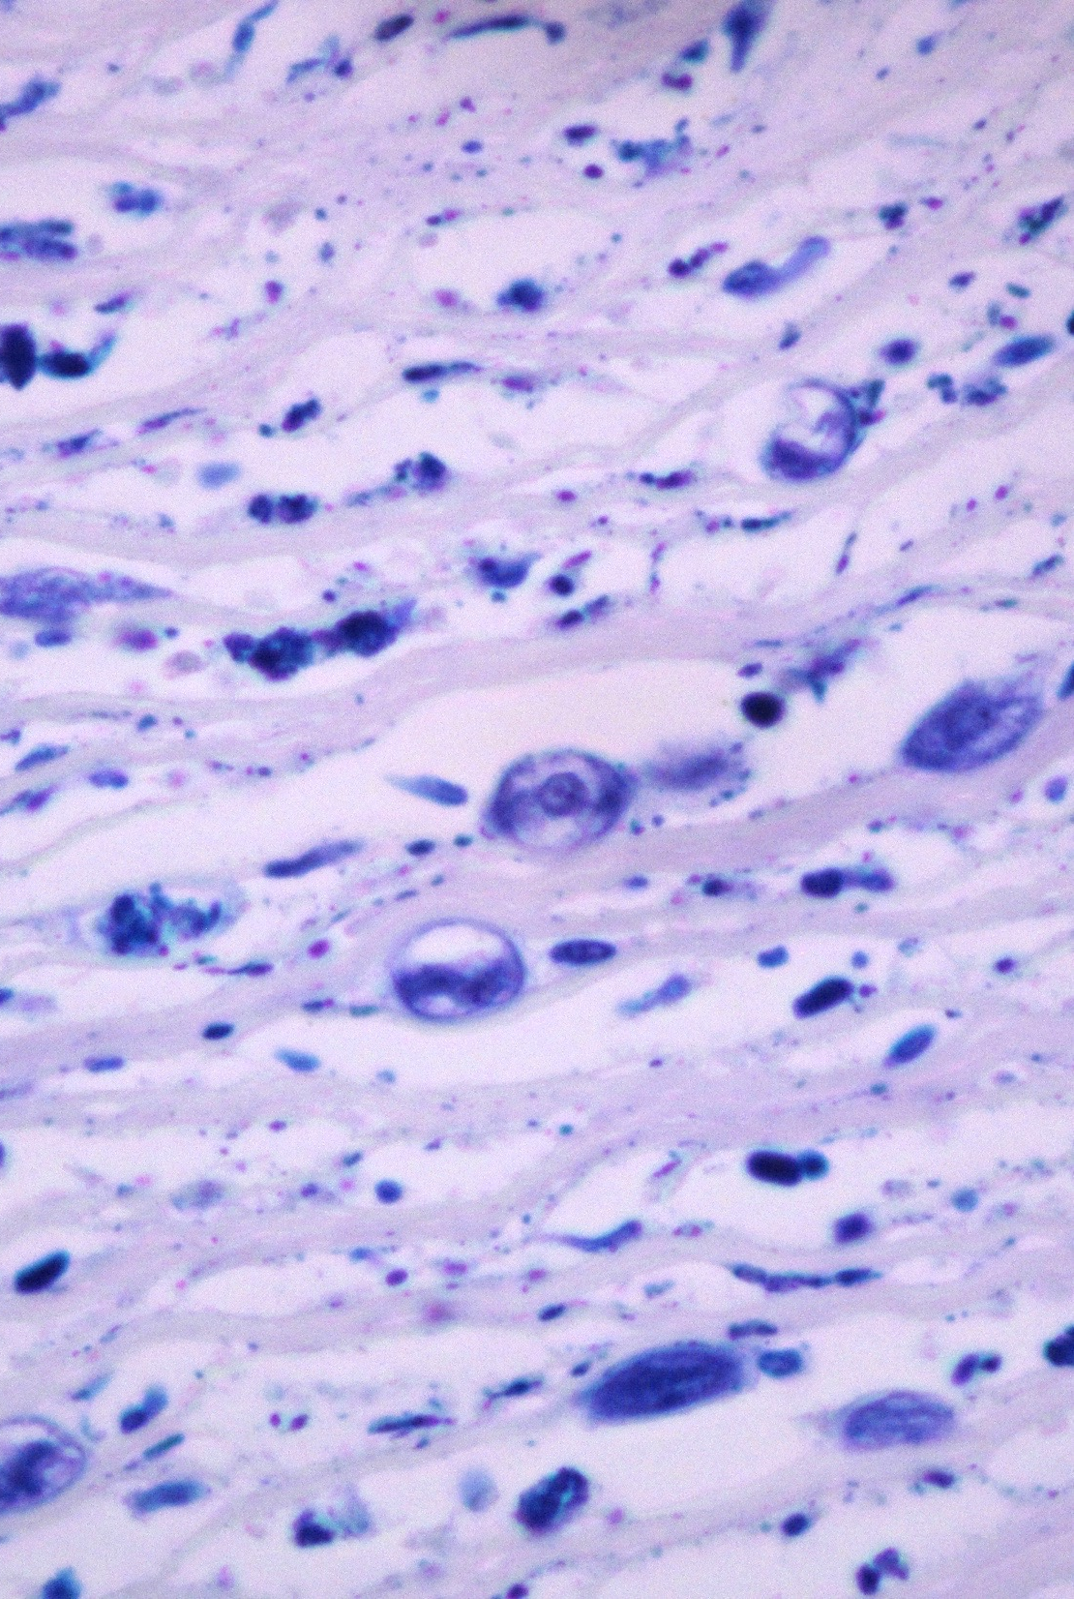
Grocott
Giemsa

Slide 10
Diagnosis
Acanthamoeba Keratitis

Slide 11
Follow-up
Treatment with prednisolone, tropicamide + phenylephrine and valacyclovir
Negative culture
Nodular infiltrate developed in the recipient cornea and inflammatory infiltrate in the posterior surface of the donor corneal button, hyperemic conjunctiva and scleral nodule with probable penetration into the anterior chamber

Slide 12
Treatment
Enucleation

Slide 13
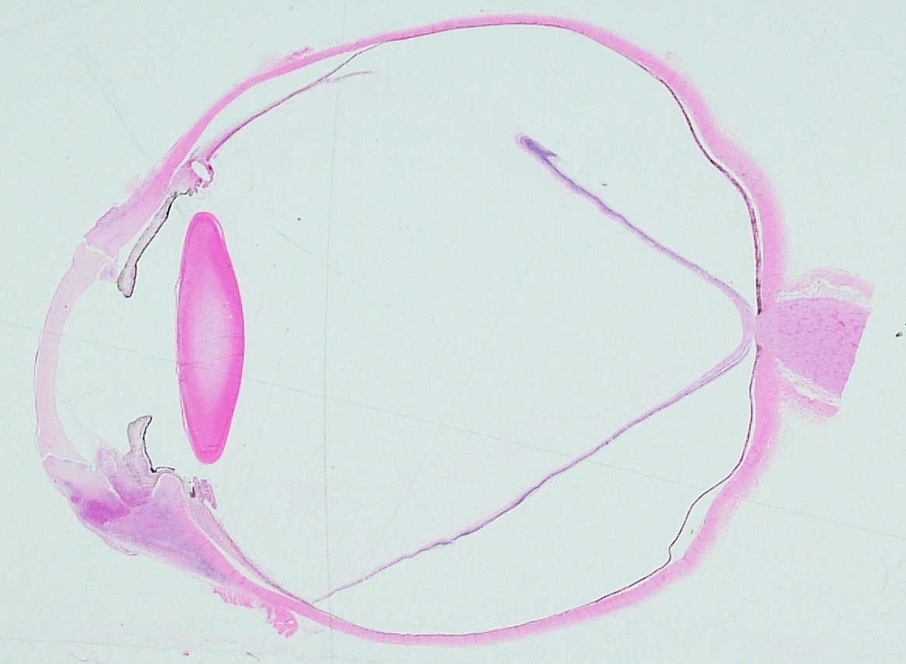
H&E

Slide 14
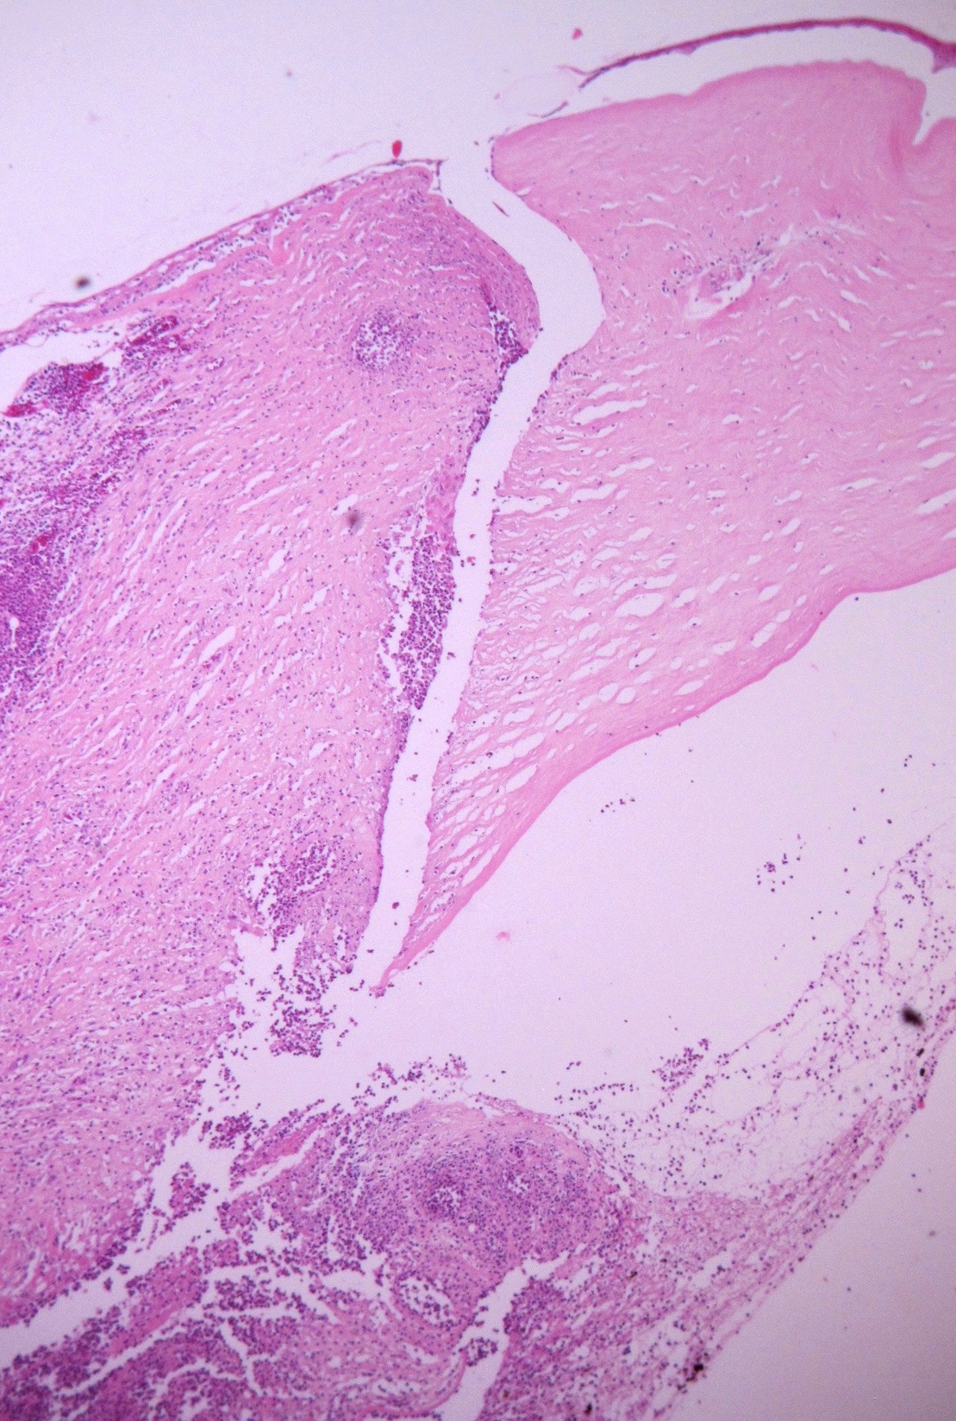
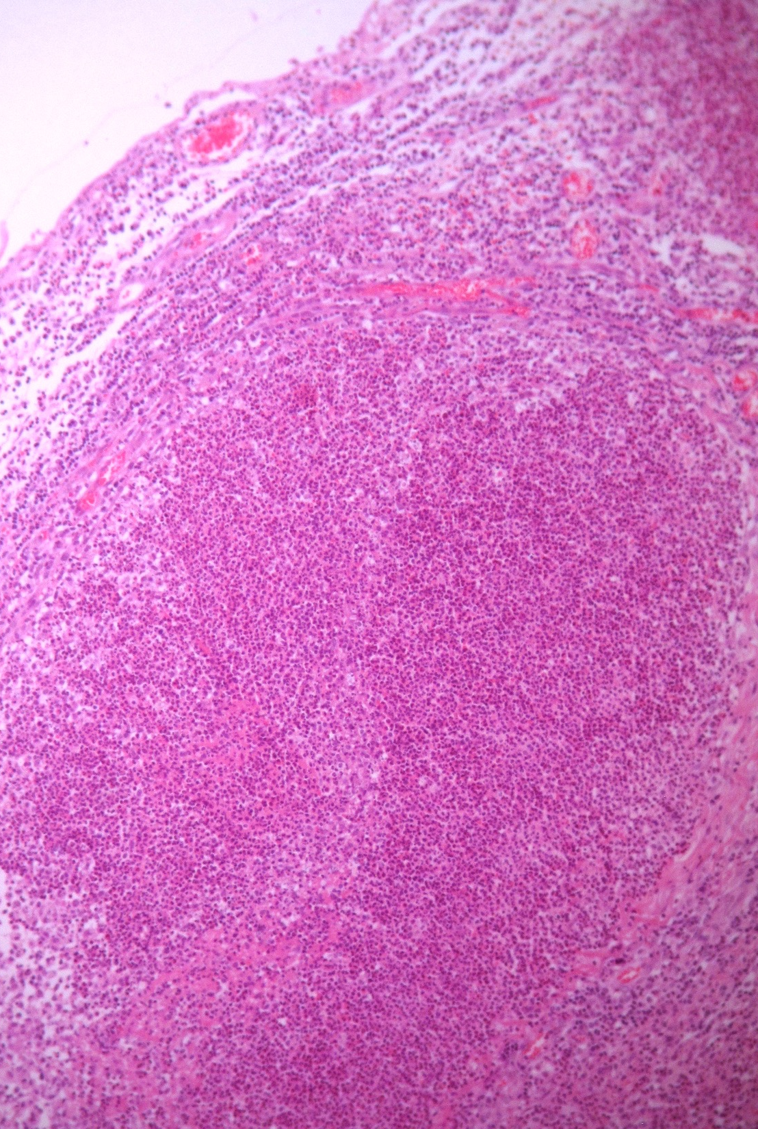
Recipient cornea
Donor cornea
Interface
AC
H&E
H&E

Slide 15
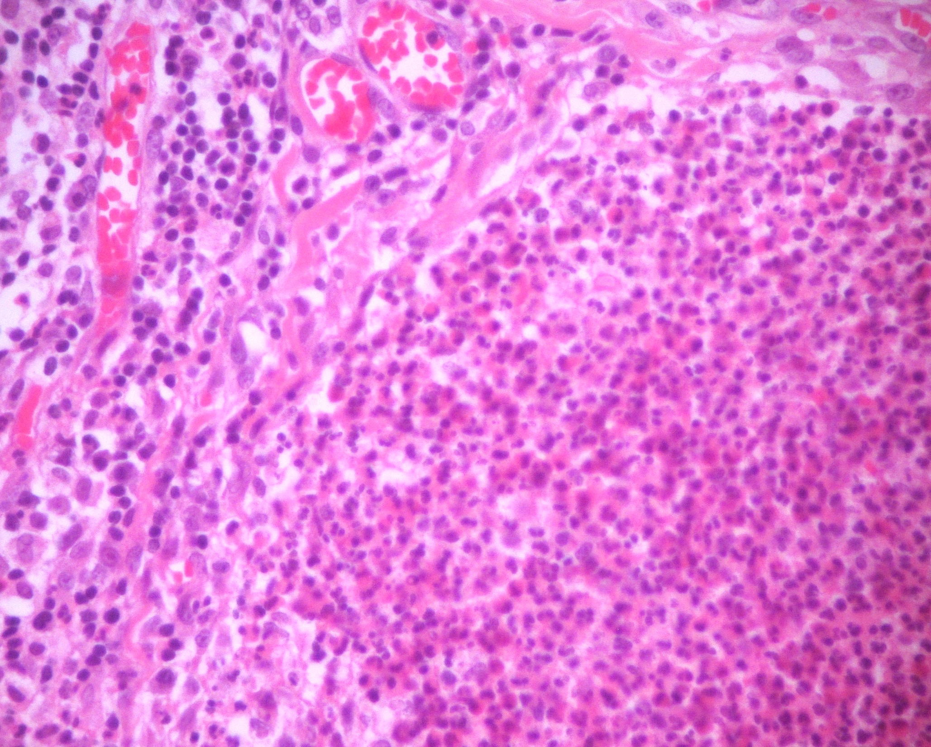
H&E

Slide 16
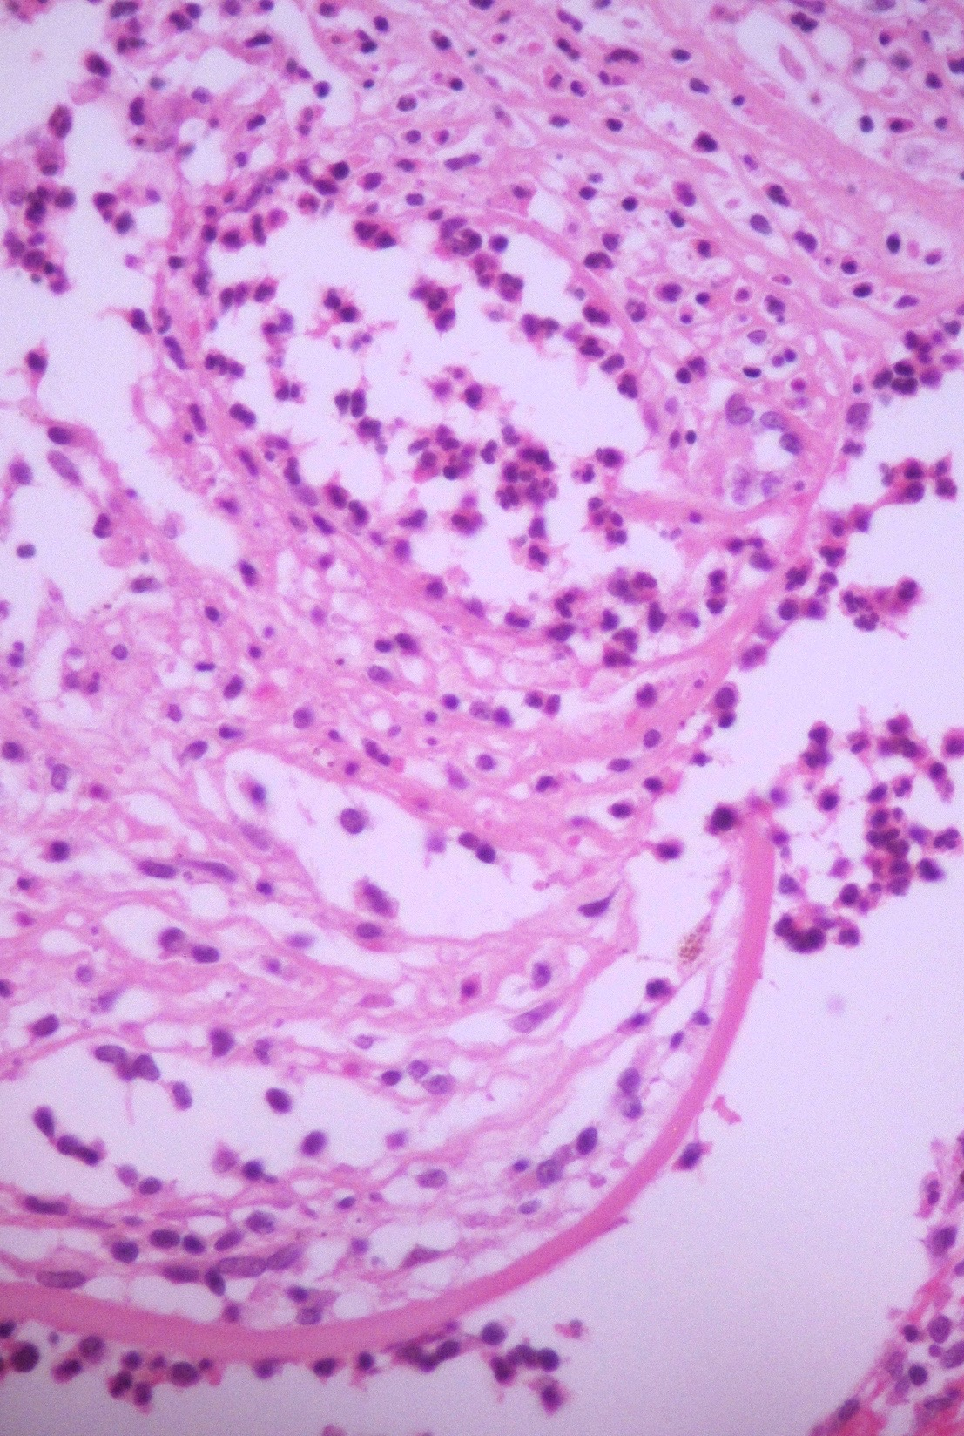
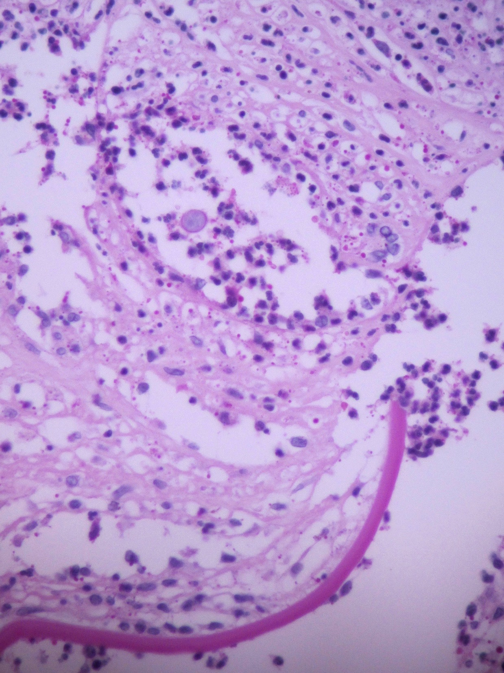
Cyst
H&E
PAS

Slide 17
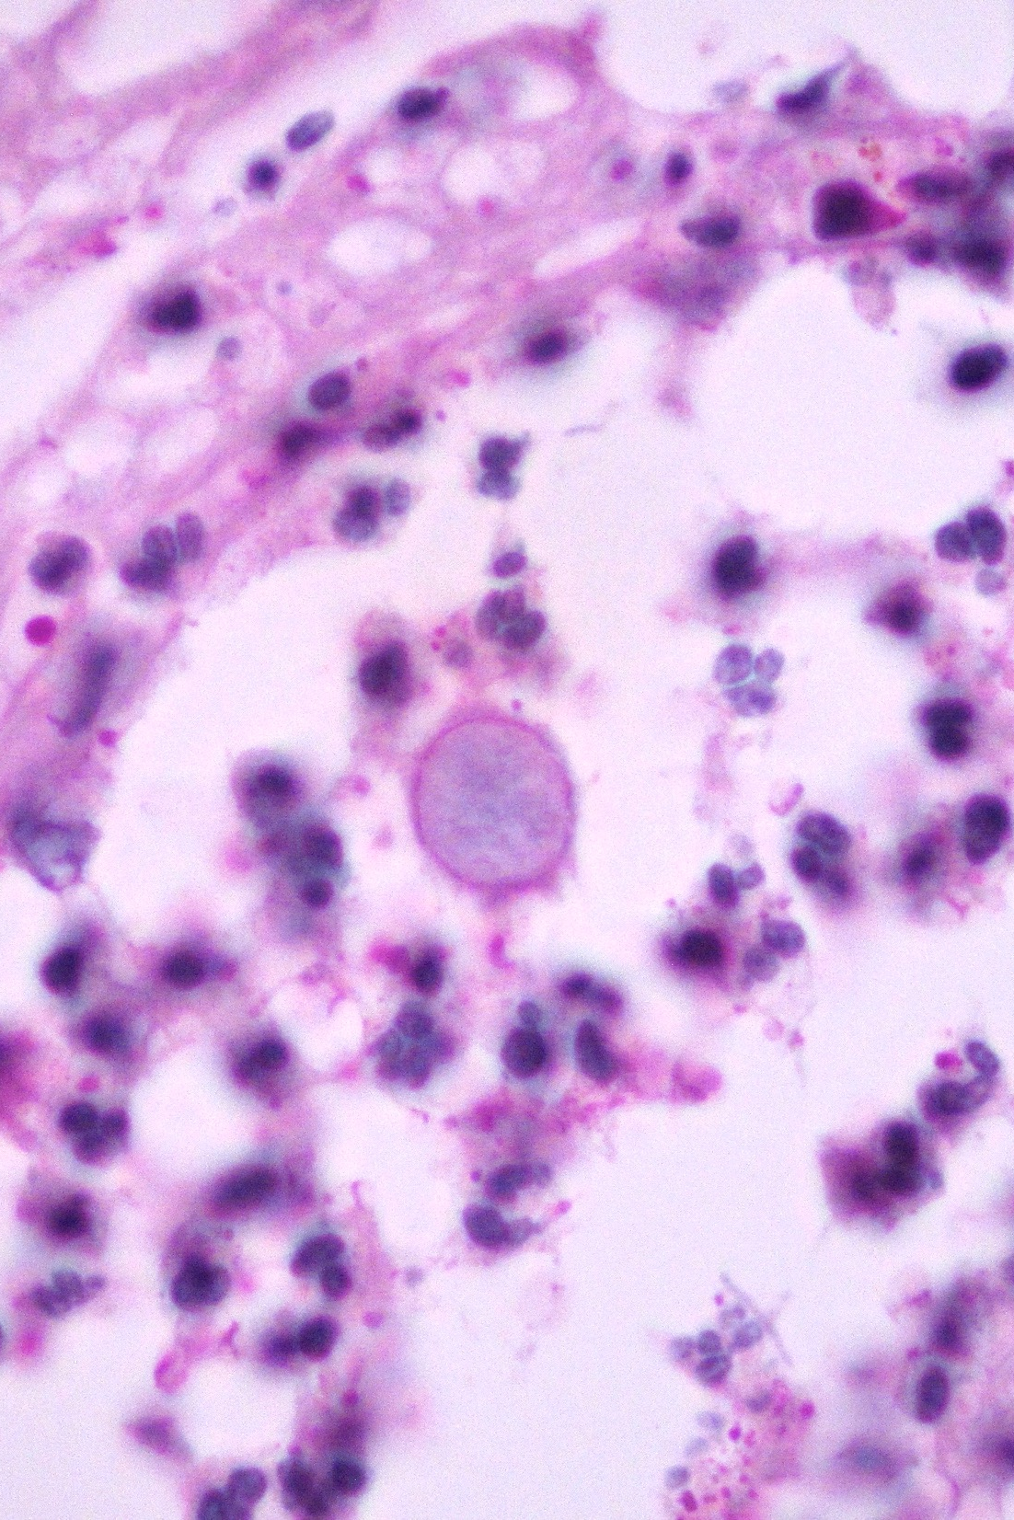
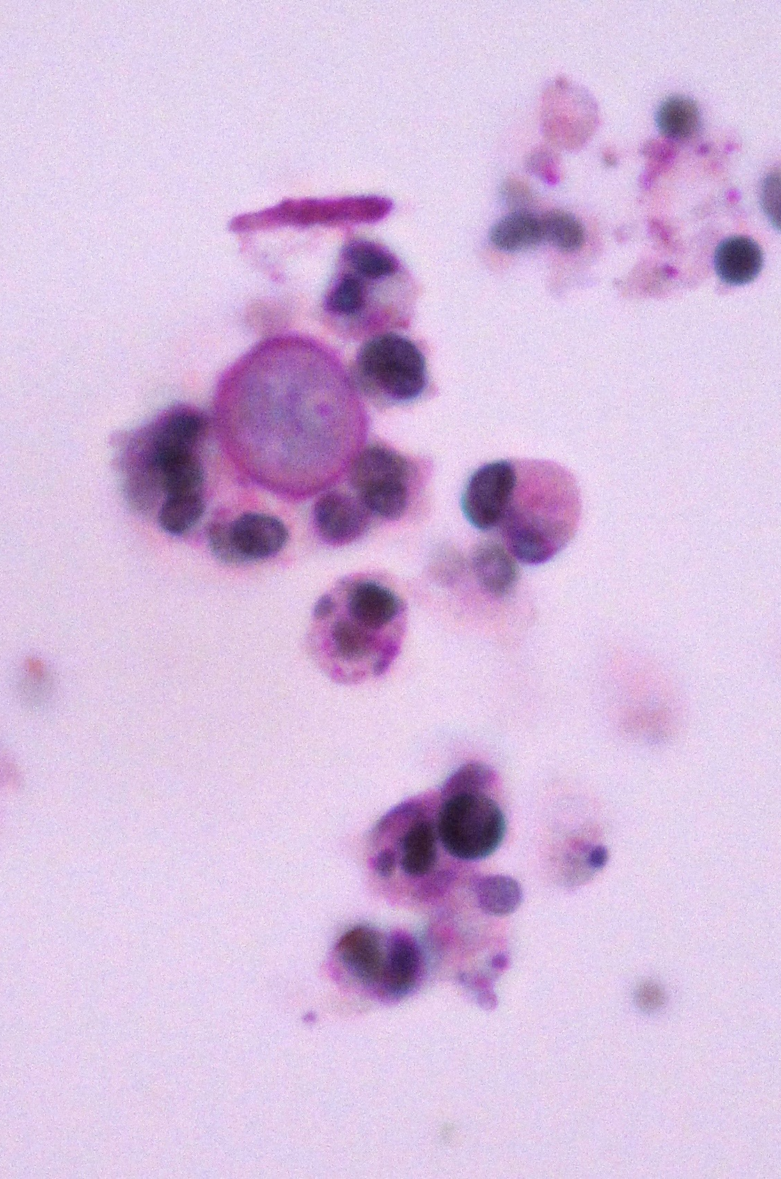
PAS
PAS

Slide 18
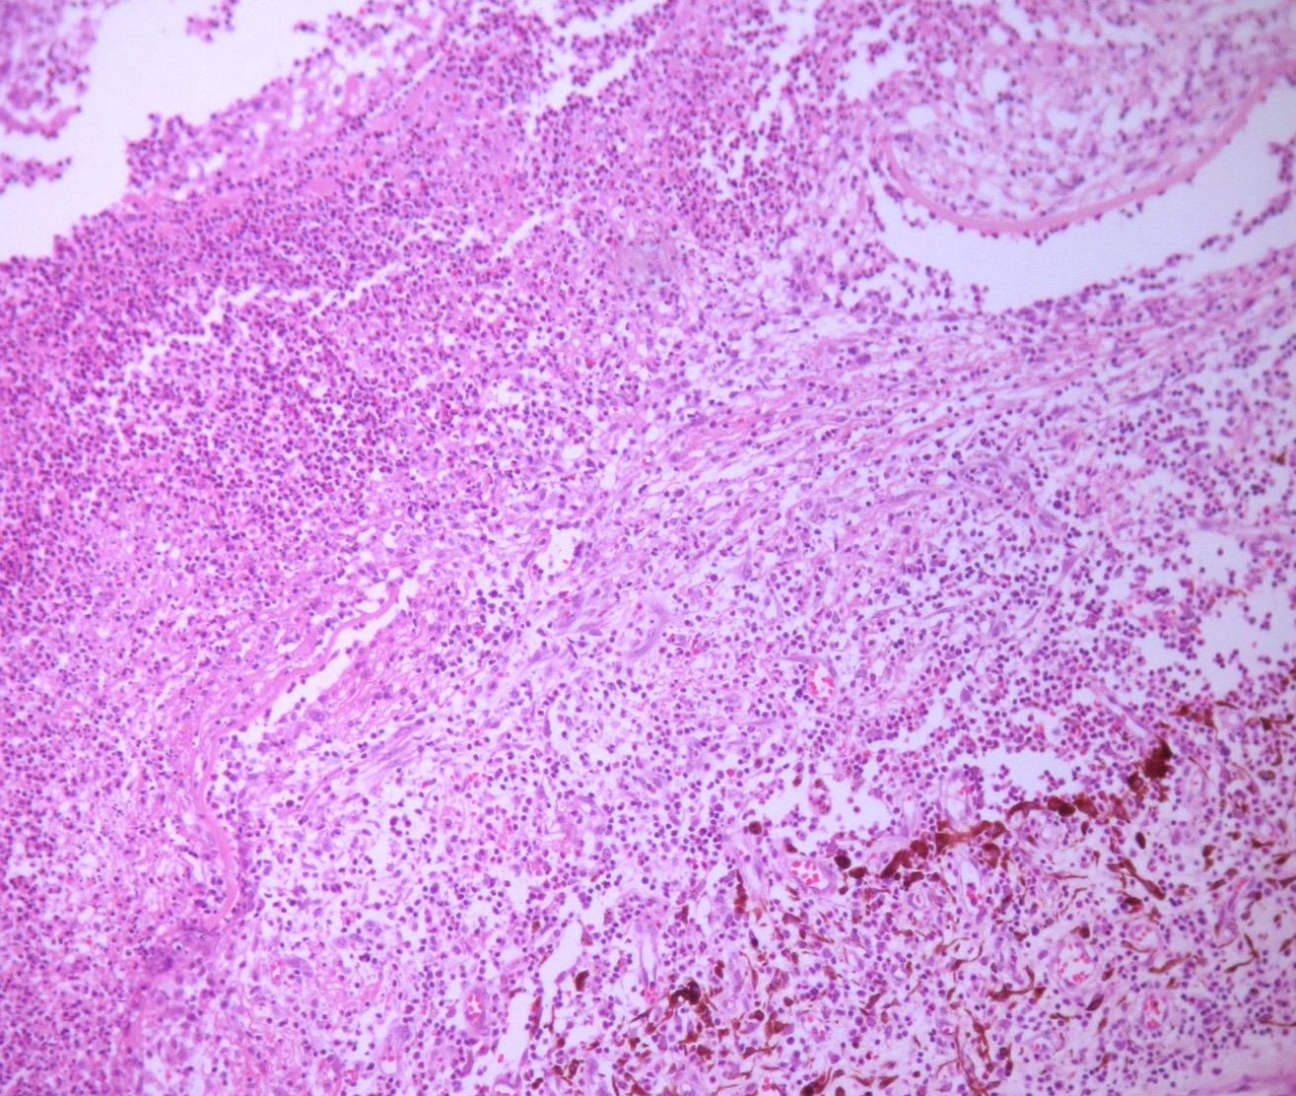
Descemet
AC
Iris
Descemet
H&E

Slide 19
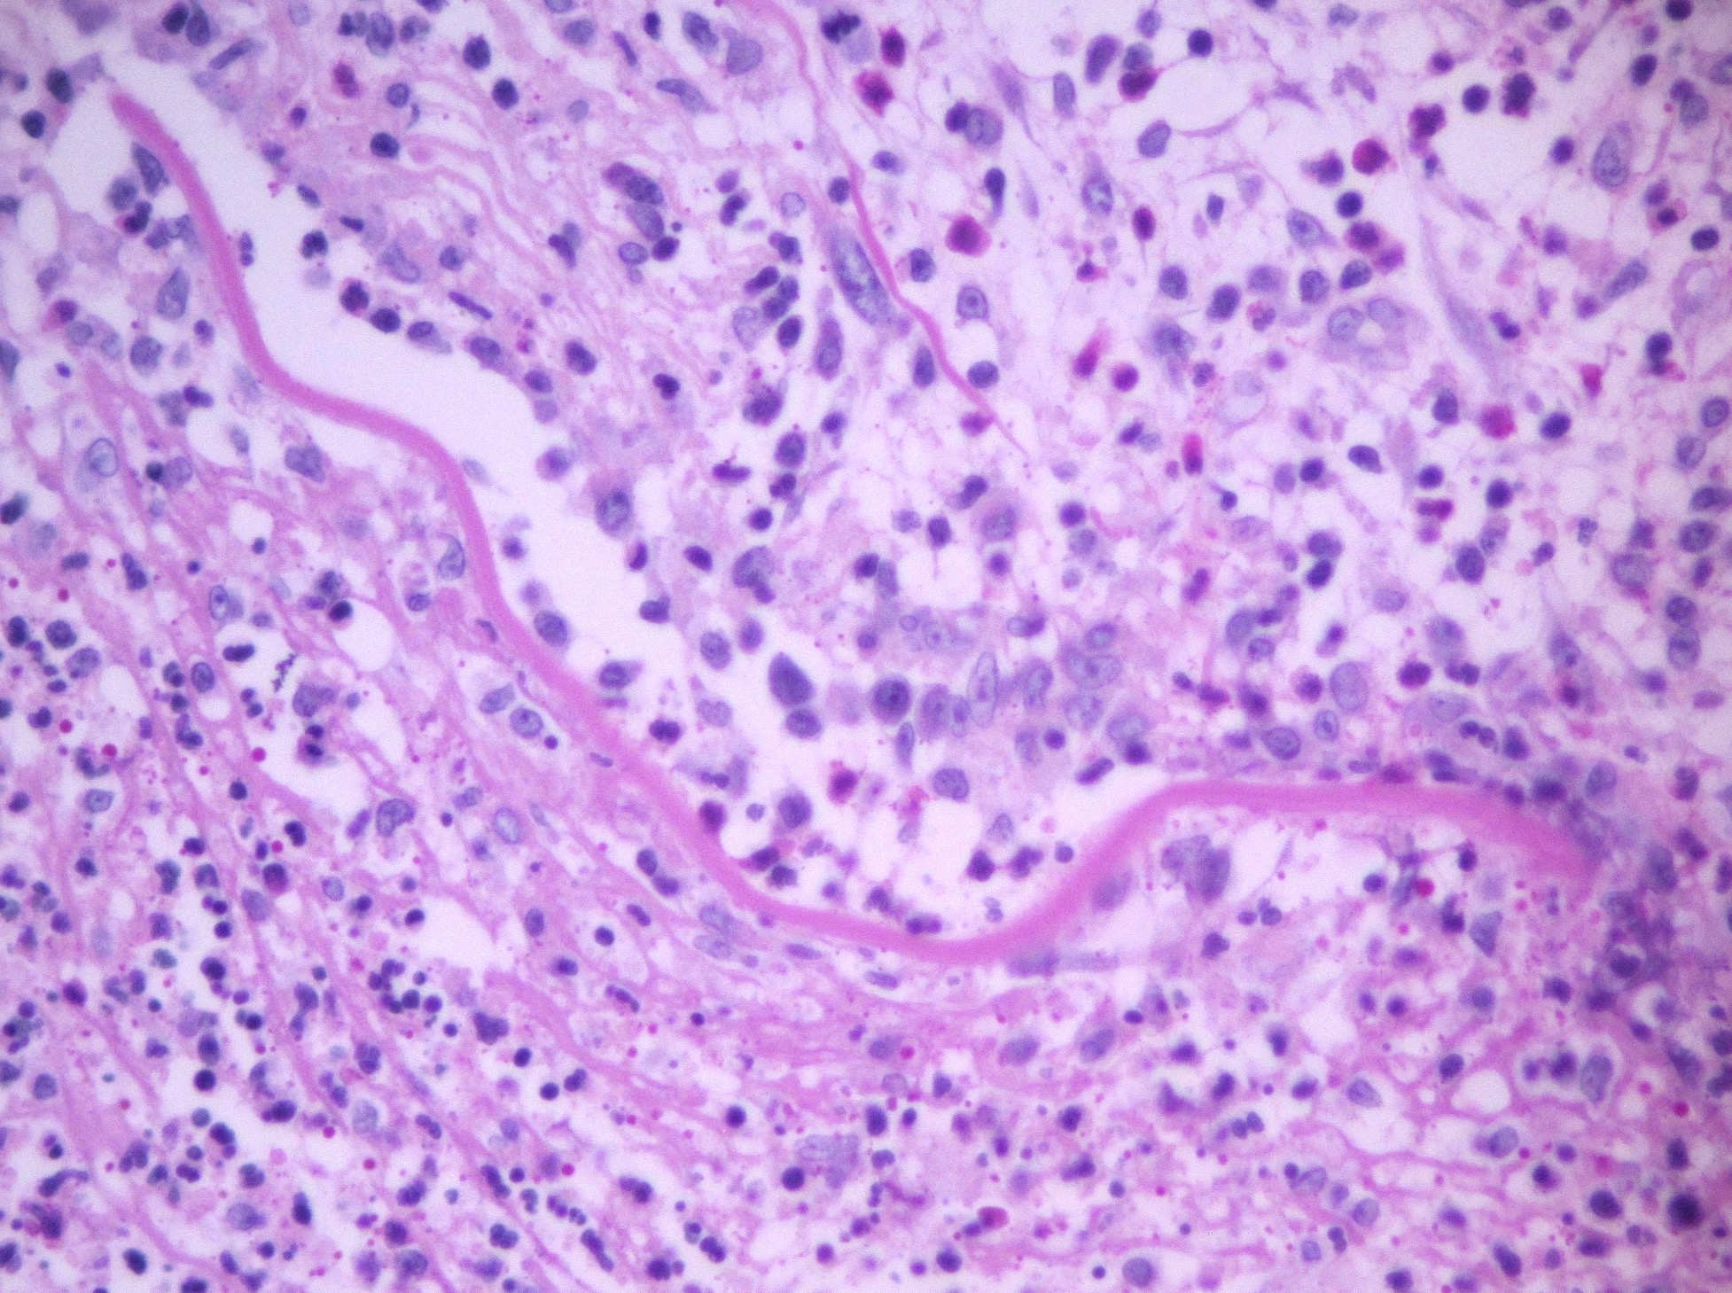
PAS

Slide 20
Final Diagnosis
Acanthamoeba Sclerokeratitis

Slide 21
Acanthamoeba Sclerokeratitis
Acanthamoeba free living parasite
Vegetative growth: Trophozoite
Dormant stage: Cyst
AK severe corneal infection, rare, contact lens eyewearers
ASK complication in 14-16% cases
Uncertain pathogenesis:
- Secondary immunologic reaction
- Invasion of the sclera by Acanthamoeba
Ophthalmology 2014;121(12):2340-7.

Slide 22
Acanthamoeba Sclerokeratitis
Cyst highly resistant to physical, chemical and drug agents vs. amoebas
Acanthamoeba cyst deep sclera
Abscesses in cornea and limbus
Deep sclera granulation tissue
Acute and chronic inflammation of the anterior segment. Does not affect posterior sclera
Enucleaction indicated for suspected endophthalmitis or corneal perforation
Histopathological examination of Acanthamoeba sclerokeratitis. Clin Ophthalmol 2014;16(8):251-3.

Slide 23
Thank You!
arodri2@yahoo.com

Slide 24
ACKNOWLEDEGEMENTS
Dolores Ríos y Valles-Valles, M.D.
Ivette Hernández-Ayuso, M.D.
Juan Manuel Vanin-Viscay, M.D.
Héctor A. Rodríguez-Martínez, M.D.
Histotech. Zoila Romero-López
Histotech. Karen T. Pohlmayer-Hurtado
Histotech. Héctor Trinidad-Bibiano

